Slide 1
Dual-pol obs in NW Environment
B. Dolan and S. Rutledge
OLYMPEX planning meeting
Seattle, 22 January 2015

Slide 2
Rainfall

Slide 3
Examined 2 Cases with KLGX
What does polarimetric S-band radar contribute to rain fall estimation in the type of systems targeted by OLYMPEX?
2 Cases
  November 17-19 2013
  February 16-18 2014
  Polar data (only lowest elevation)

Slide 4
Advantage of Pol data in rainfall
Using parameteric relationships / specific differential phase (Kdp) helps to minimize assumptions about drop size distribution, convective/ stratiform that plague direct Z-R estimates
  R(Zdr, Kdp)
  R(Zh,Zdr)
  R(Kdp)
  R(Z)
Algorithm selects the best relationship given the quality of the pol data (e.g. above the ‘noise’)
  Kdp > 0.3 AND Zh > 38 dBZ
  Zdr > 0.5 dB

Slide 5
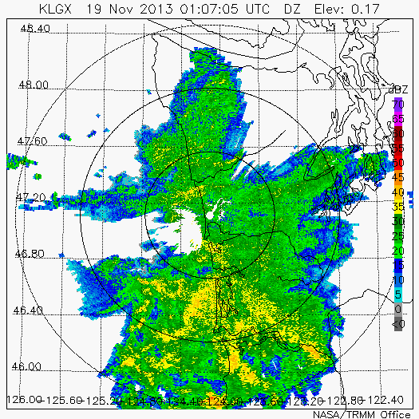
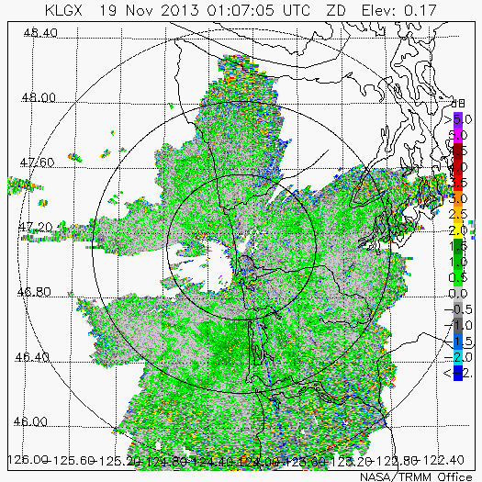
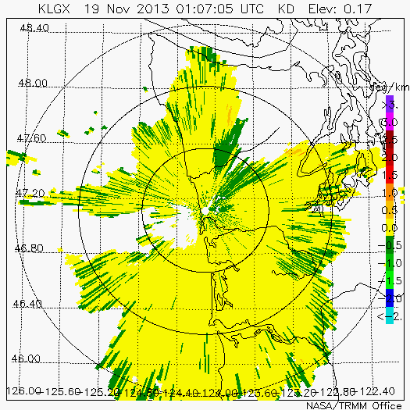
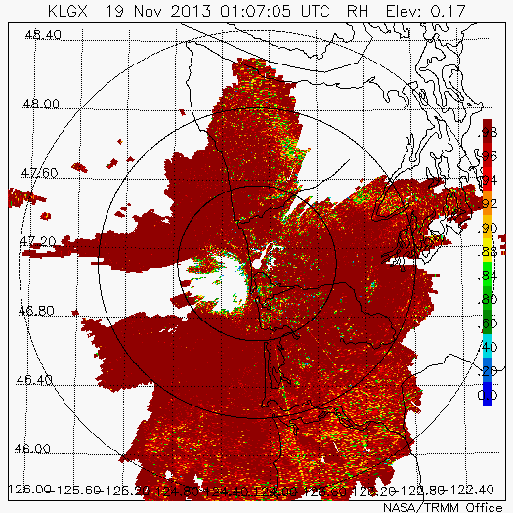
The Mundane….
Case 1 (Nov 18-19 2013)
Zdr
Fairly small polarimetric signatures
  Zdr < 1.0 dB
  Kdp < 0.5 º/km
Kdp
ρhv

Slide 6
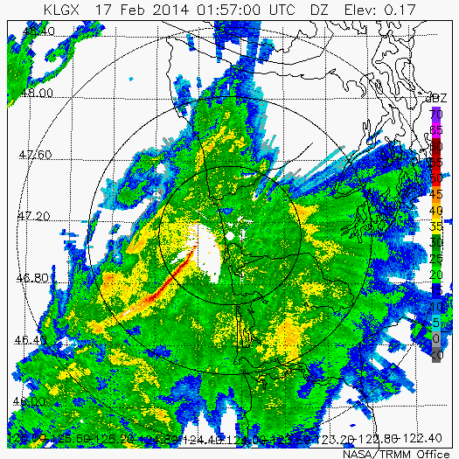
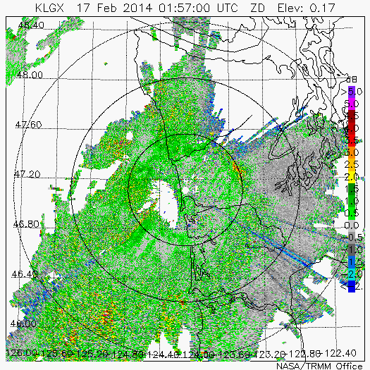
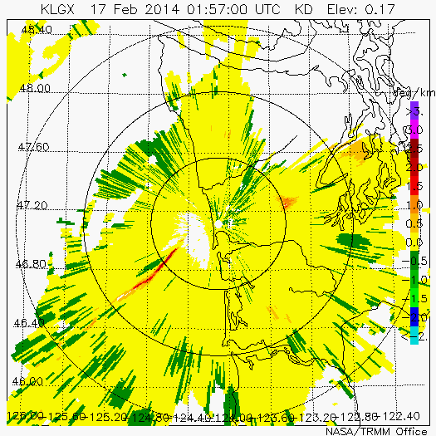
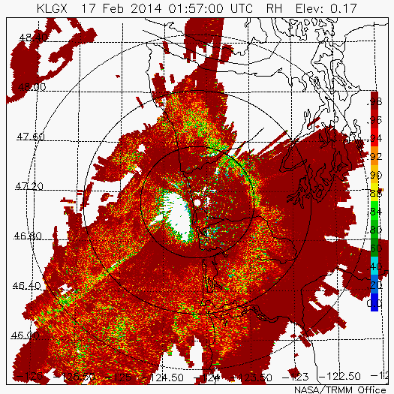
….To the Interesting
Case 2 (Feb 17-18 2014)
Zdr
Blockage
Strong embedded convective line (~50 dBZ)
Even some differential attenuation at S-band (!)
Kdp
ρhv
Interesting bright band / terrain interactions

Slide 7
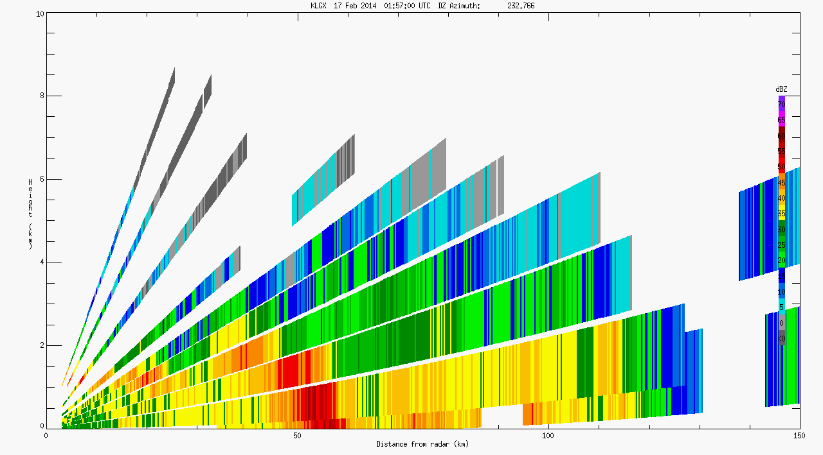
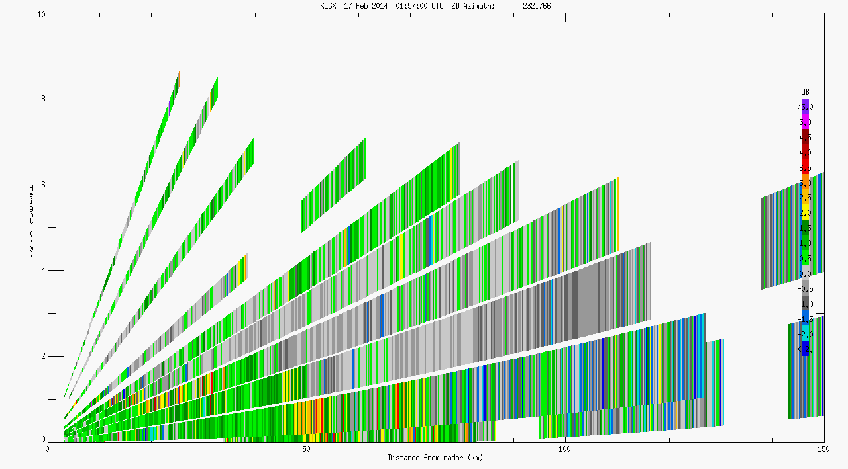
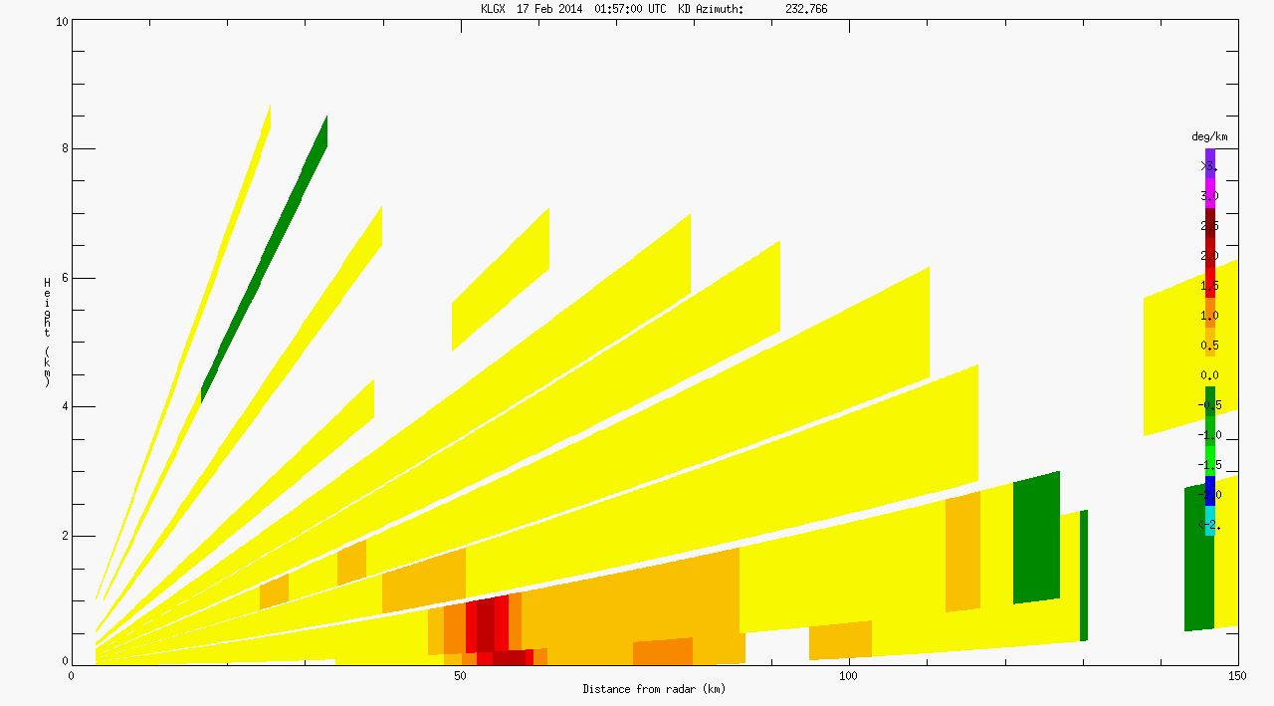
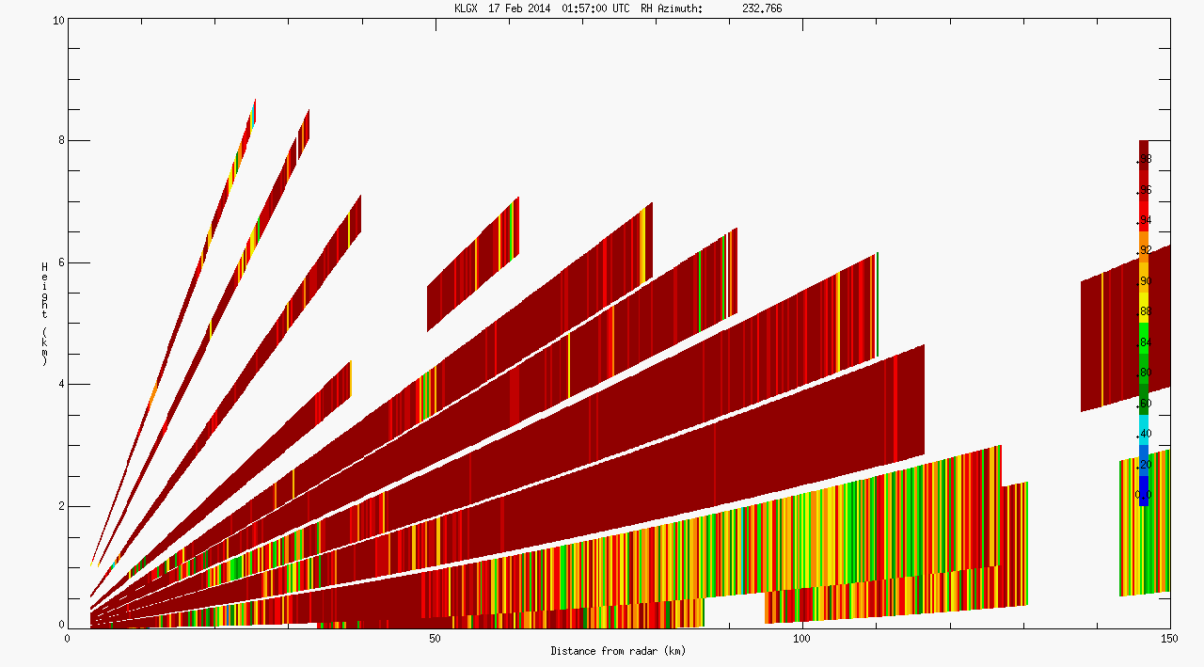
Cross-section Example
10
10
6
6
2
2
10
10
6
6
2
2
Interesting microphysical signatures
  Aggregation
NPOL/ DOW/D3R will bring hi-res vertical data
~6-8 km deep
Melting Layer

Slide 8
PDFs of KLGX S-band Polarimetric data
20
30
30
DZ
Z_{dr}
K_{dp}
Nov 19
15
Nov 18
20
20
Feb 16
Frequency
Feb 17
Frequency
Frequency
10
10
10
5
0
0
0
0
20
DZ bin
40
60
-2
0
Z_{dr} bin
2
4
-1.0
-0.5
0
0.5
1.0
K_{dp} bin
Thresholds for use in rain estimation via the blended algorithm
The February case is clearly stronger than the November case , but:
Reflectivity is mostly below 30 dBZ and only <1% of the time K_{dp} exceeds 0.3 deg/km
Z_{dr} has a much more substantial signal, with the February case mostly above the threshold

Slide 9
PDFs of rain estimation KLGX parameters
100
100
90% of rain rates are < 10 mm hr⁻¹
80
CDF of Rain rate
1
.01
60
Frequency
Frequency
Nov 19
40
.000001
Nov 18
Rain rate PDF
Feb 16
20
Feb 17
0
10
20
30
40
0
10
20
30
40
50
Rain Rate bin (mm/hr)
Rain Rate bin (mm/hr)

Slide 10
Rain volume and method: S-band
During both cases, the rain rate algorithm uses K_{dp} (either R-K_{dp}-Z_{dr} or R-K_{dp})< 5% of the time (used slightly more during February case)
R-Zh-Zdr is used most frequently in the February case, but R-Z is used more frequently in the November case
90% of rain rates are < 10 mm hr⁻¹

Slide 11
Hydrometeor Identification

Slide 12
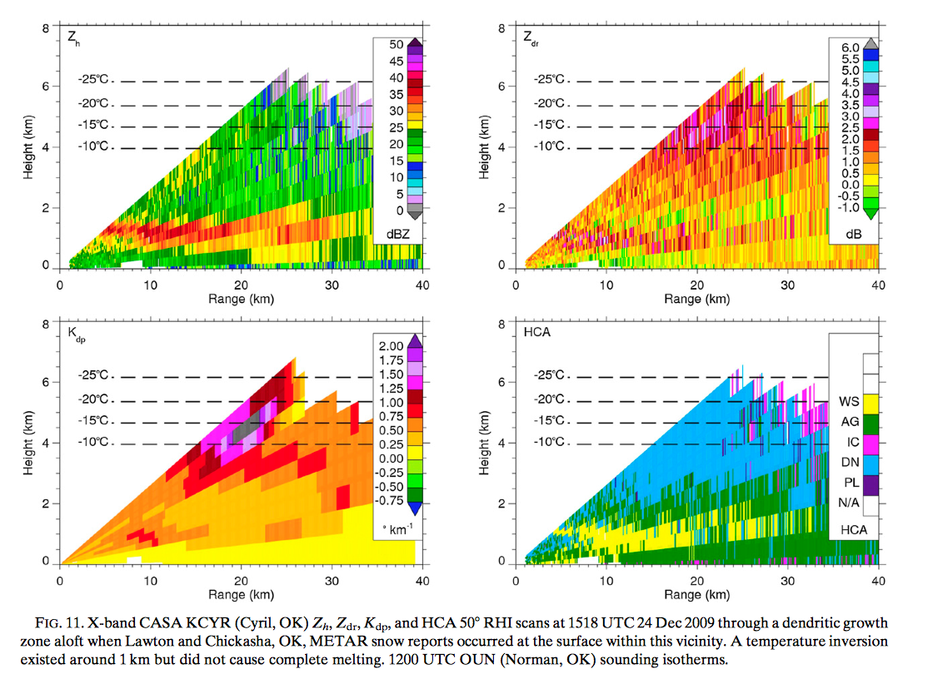
X-band cold-season HID Example
Enhanced region of Zdr
Clear bright band
Coincident enhancement of Kdp around -15 ºC
Dendritic growth zone
Aggregation zone
From Thompson et al., 2014

Slide 13
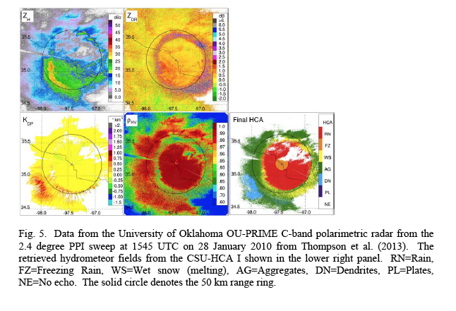

Slide 14
In Summary
Multiple frequencies will be important!
Although convection can be locally intense, K_{dp} values are predominately too low at S-band for use in rain rate estimation
  X-band would increase K_{dp}s by 3x, and could be used for rain rates of ~ 2.5 mm hr⁻¹ (Matrosov et al. 2006)
  Use X-band to ‘tune’ the S-band algorithm?
  D3R will be important for light rain estimation
Z_{dr} can provide some additional constraints on rain estimation, especially in heavier cases
Both X-band and S-band will provide nice microphysical data, especially in the vertical

Slide 15
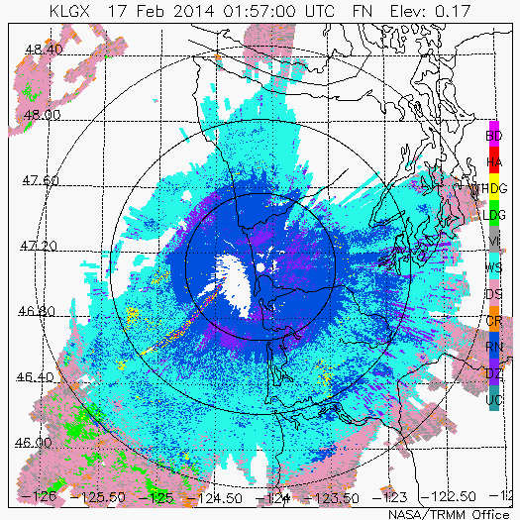
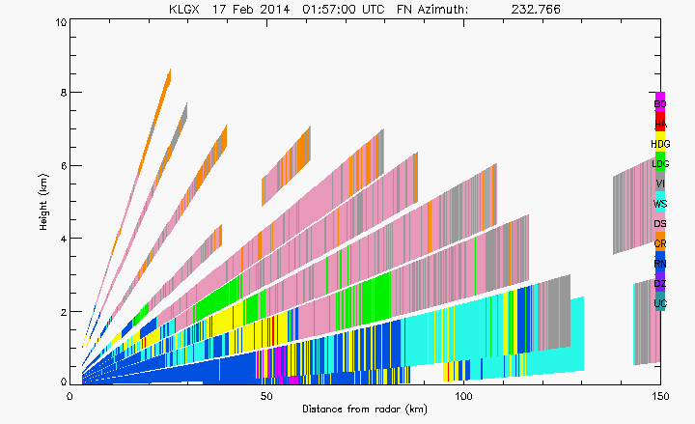
KLGX HID
Case 2 (Feb 17-18 2014)

